Slide 1
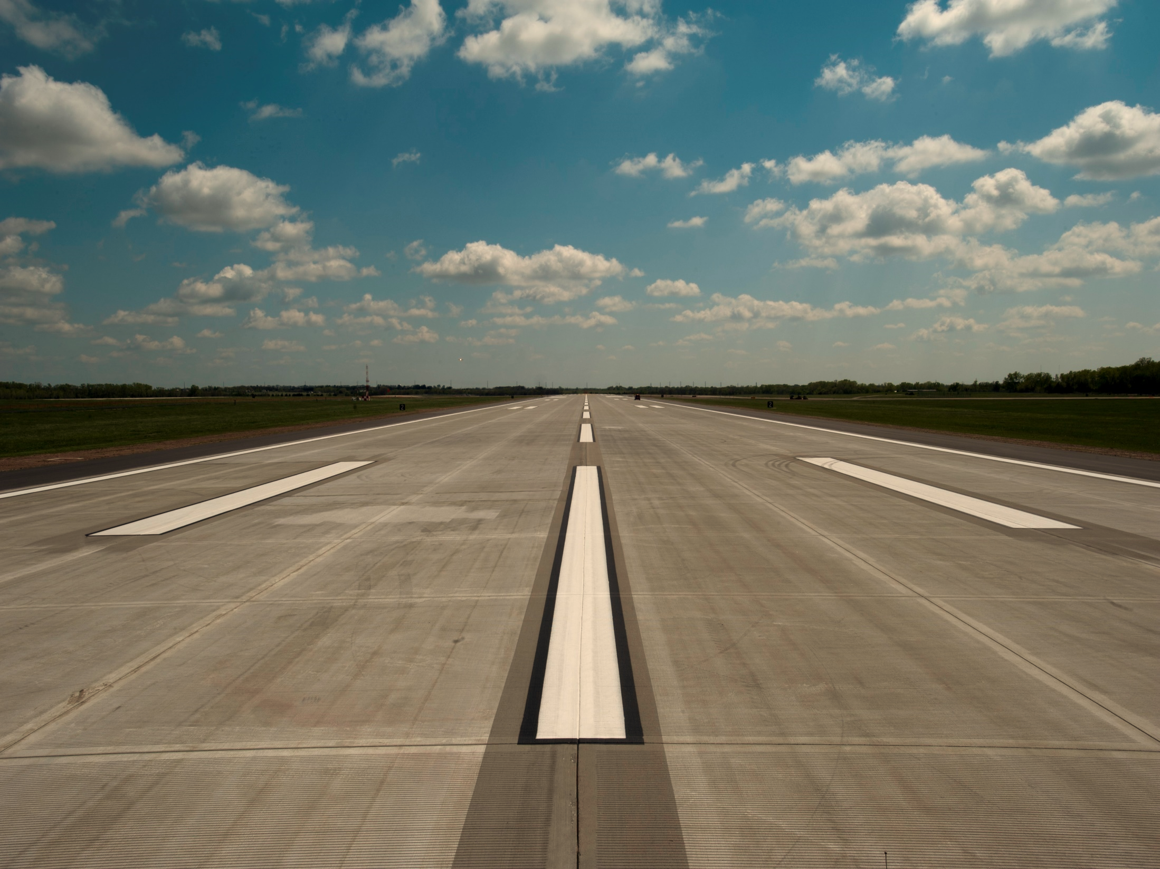


Object detection on the runway
with Stereo-RCNN CS470 Introduction to Artificial Intelligence
Team 32 (Stereo-RCNN)
Ji il Park, Hyunyong Jeon,
Leon Thormeyer
2019. 12. 2. (Mon)

Slide 2
Contents
Introduction
Why object detection on the runway
What is Stereo-RCNN
Experimental Design
Hardware setup
Algorithm modification
Test & Results
Data acquisition
Performance of Object detection
Conclusions & Further Work
stereo란t

Slide 3
Introduction

Slide 4
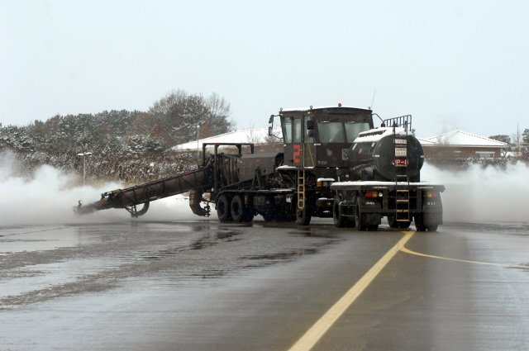
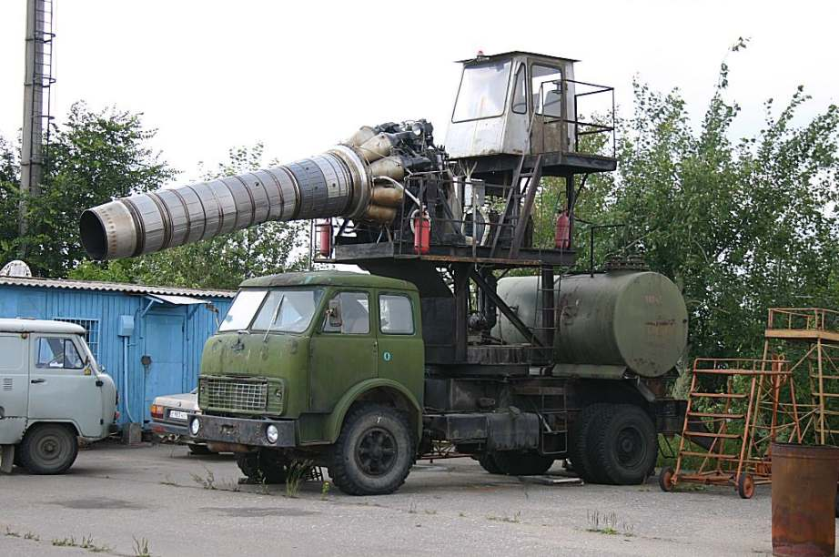
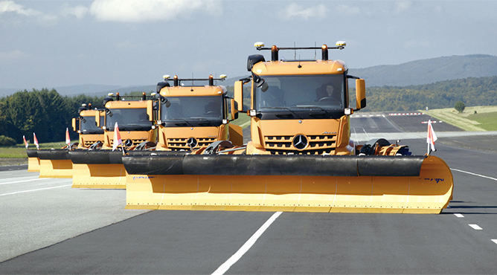
Why object detection on the runway ?
Snowplow vehicle need 3D object detection ability
Runway snowplow of each country
Korea
Russia
Germany
Runway snowplows need to remove stacked snow when it snows.
It means that it is difficult to use lidar that is vulnerable to falling snow.
Therefore, we need to detect the object with vision camera.
* Radar reduces detection range by more than 50% when snowing.
* Snow filtering lidar data is also reduced by more than 50%.
Just in case, we need the 3D object detection ability by using just vision camera.
→ For these reason, we decide to find 3D object detection model based on stereo vision camera.
[1] https://github.com/HKUST-Aerial-Robotics/Stereo-RCNN.

Slide 5
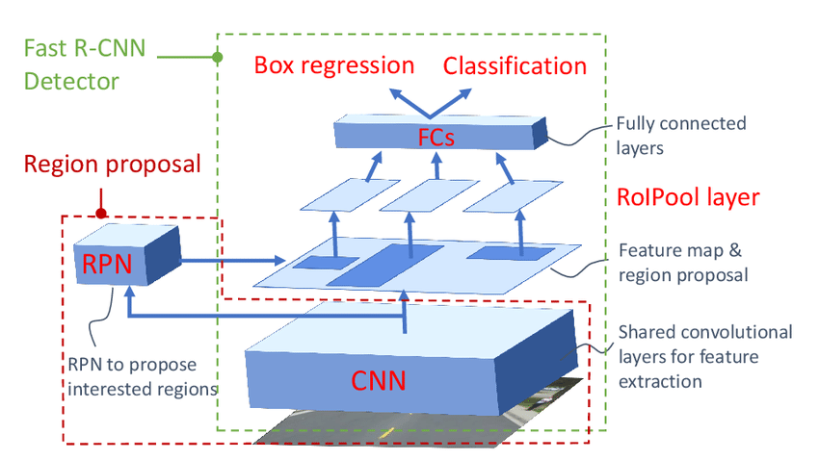
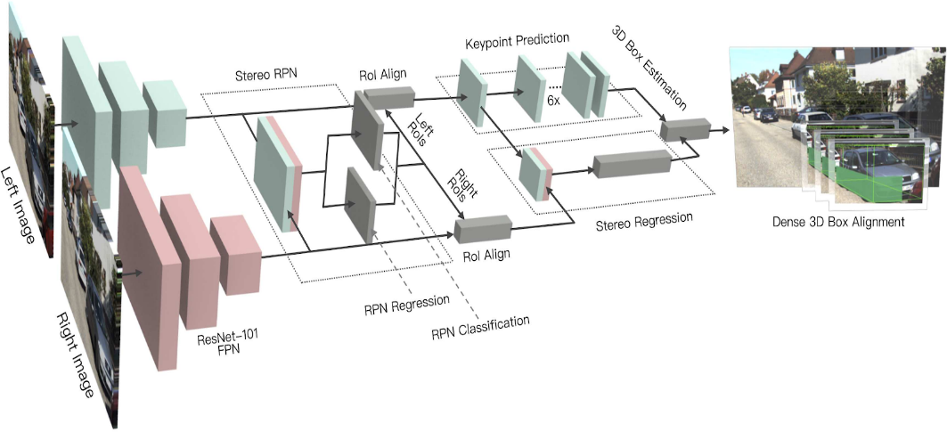
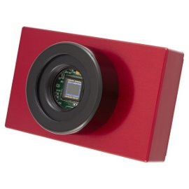
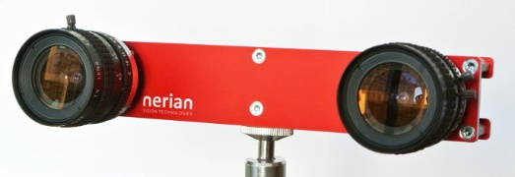
What is Stereo-RCNN ?
Network architecture of Stereo-RCNN
Faster-RCNN Architecture
Stereo-RCNN Architecture
Stereo-RCNN can infer
depth of multi objects so
can make 3D bounding box
Faster-RCNN use mono image
So only make 2D bounding box
This algorithm extends Faster-RCNN for stereo inputs to simultaneously detect 3D bounding boxes by using the left and right images.
This algorithm is essential for autonomous driving with vision cameras without lidar.
[1] https://github.com/HKUST-Aerial-Robotics/Stereo-RCNN.

Slide 6
Experimental Design

Slide 7
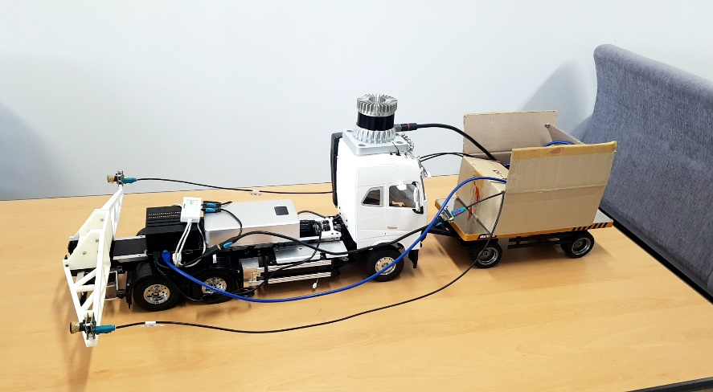
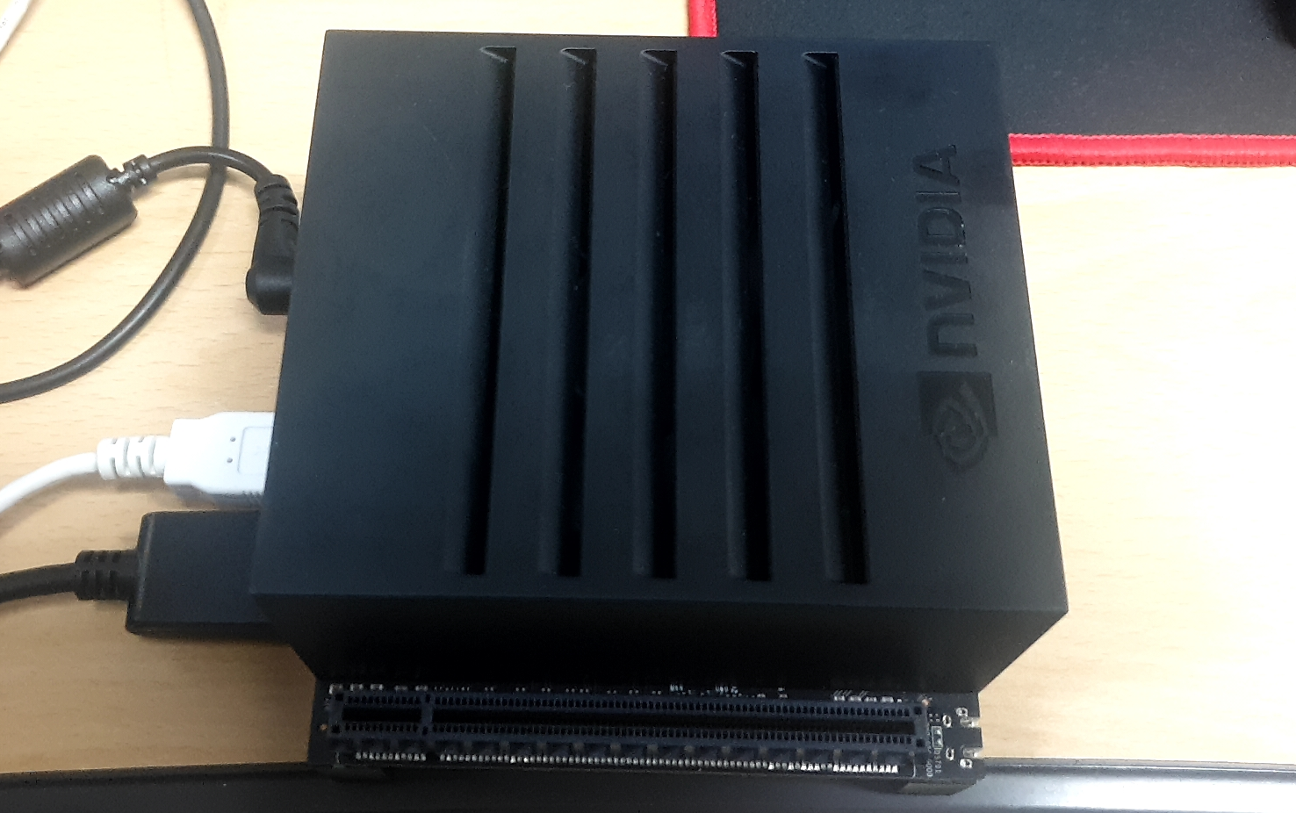
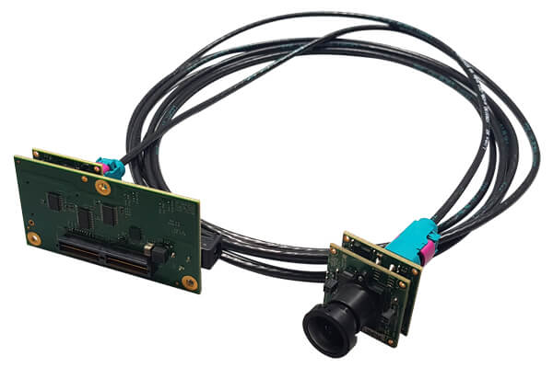
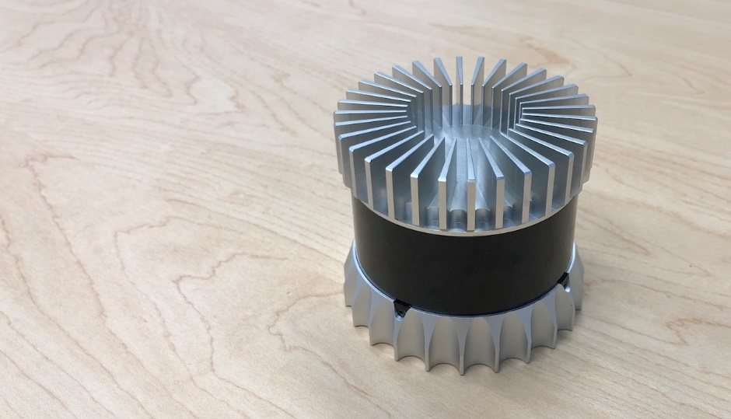
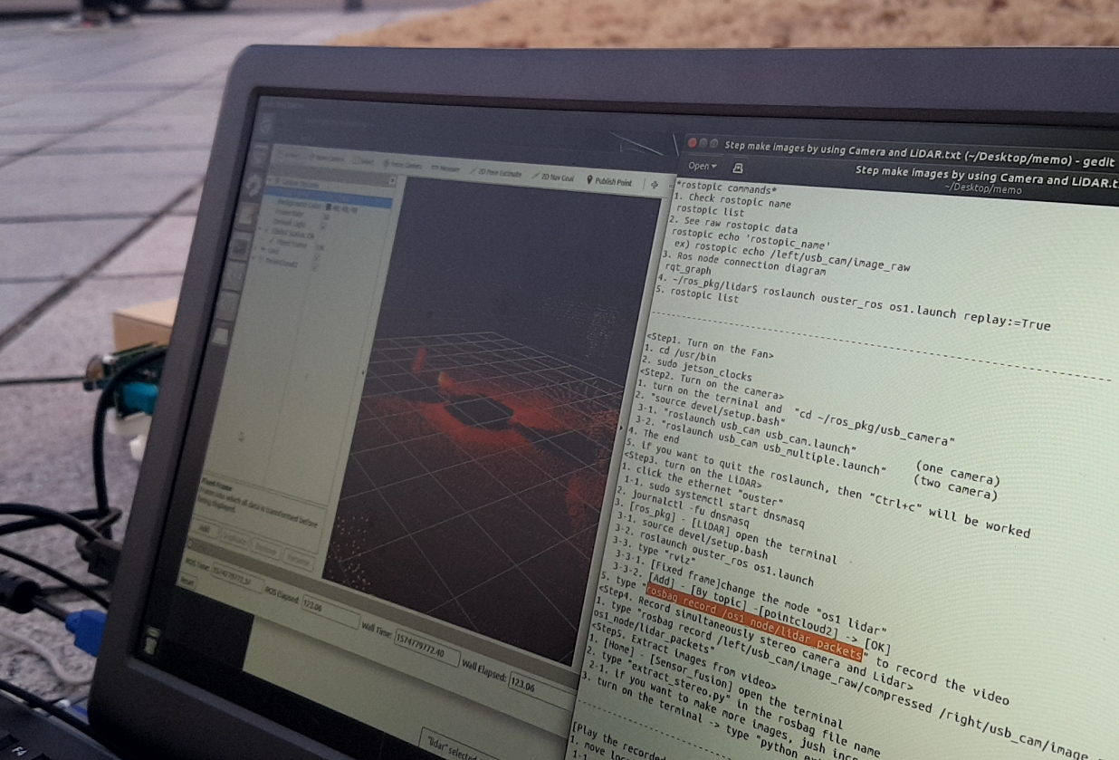
Hardware setup
Sensor(Stereo camera + LiDAR) mounted RC car model for Object Detection
Lidar
(Not used)
Camera 1
Baseline
(0.54m)
Xavier
Camera 2
RC car model for autonomous driving
Nvidia Jetson AGX Xavier Dev. Kit
(GTX 1060 ti grade performance)
Tried to combine camera
3d object detection and lidar
point cloud, but it was excluded
because of lack of time
NileCAM30_USB camera for stereo vision (2set)
Ouster 64-channel LiDAR

Slide 8
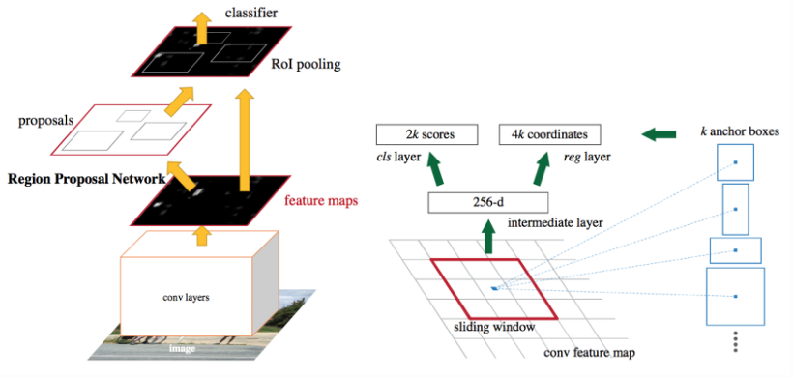
Algorithm modification
Try #1
Resnet algorithm improvements.
→ Since the Resnet 152 model is already applied, performance improvement is limited.
Apply other models.
→ Applied Resnet+Google inception known for good performance but rather can’t detect the object (Unknown reason)
→ VGG model performs poorly compared to Resnet, as is known in several papers.
Decided to modify RPN part of Resnet.
→ Resize the anchor shape to fit objects on the runway such as air plane.
Try #2
Try #3

Slide 9
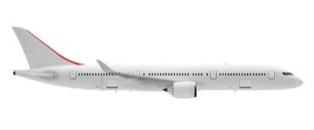
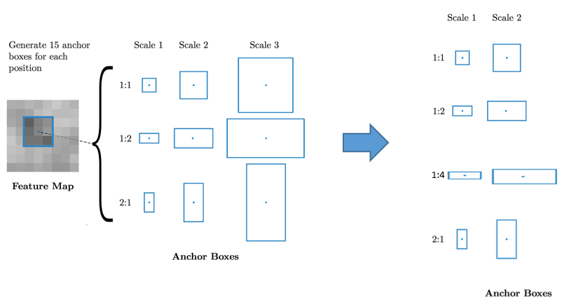
Algorithm modification
RPN modification
※(Assuming) 1. Operating environment : Airplane runway
2. Expected target object : Air plains, vehicles, and unknowns
Need to change the appropriate anchor size for the operating environment.
The object to be detected in the runway environment are mainly lateral wide air planes.
As a result, we added horizontally wide anchors to identify airplanes. (1:4)
Increasing the ratio to four types may exceed the GPU processing memory, so the scale is reduced to two types in consideration of this. (change from 3-scale to 2-scale)
For vehicles
Add this type for fighter plains
For unknowns(human, etc)
Total 9 anchor Boxes
Total 8 anchor Boxes

Slide 10
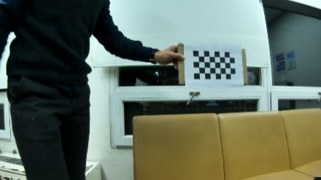
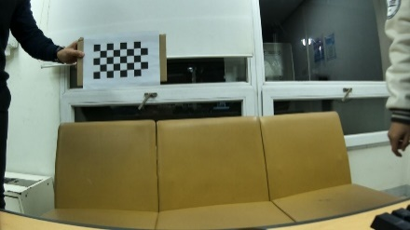
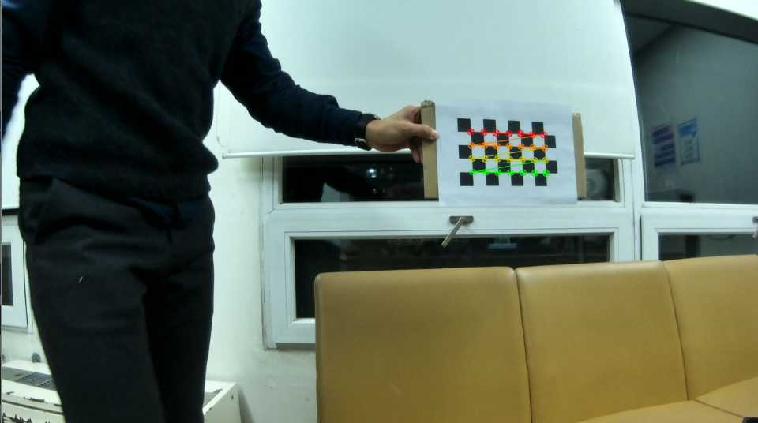
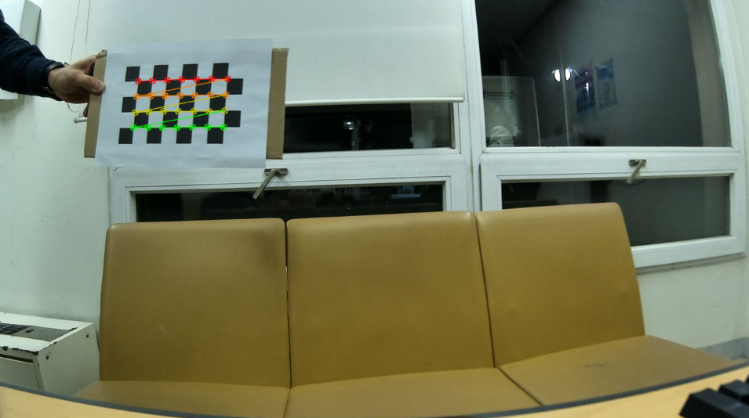
Algorithm modification
Modification of Stereo camera calibration parameter (Intrinsic & extrinsic)
Baseline : 54cm, Checker board(Grid Rows 6, Grid Cols 8, Cell size 26mm)
Left camera
Right camera
Left camera
Right camera
Camera parameters
(Left camera) rms = 0.148793, fx = 767.646362, fy = 769.060456, cx = 669.203517, cy = 388.021517,
k1 = -0.249038, k2 = 0.068186, p1 = 0.001469, p2 = -0.003465
(Right camera)rms = 0.128235, fx = 726.518247, fy = 727.059139, cx = 636.526418, cy = 310.456766,
k1 = -0.2, 16319, k2 = 0.057398, p1 = 0.004065, p2 = 0.006851
▶ focal length(fx, fy), principal point(cx, cy), radial distortion(k1, k2), tangential distortion(p1, p2)
Callibaration matrix
('Intrinsic_mtx_1', array([[ 442.7…, ]])), (‘dist_1', array([[-0.203…, …]])), ('Intrinsic_mtx_2', array([[3.839… ,]]), ('dist_2', array([[ -8.568152…, …] …])), ('R', array([[ 8.37752308e-01, …], …])), ('T', array([[ -24.72037826], …])), ('E', array([[2.02892314, …], …])), ('F', array([[1.54412202e-07, …], …]))
▶camera matrix(Intrinsic_mtx_1, 2), distortion matrix(dist_1, 2),
rotation matrix(R), translation matrix(T), essential matrix(E), fundamental matrix(F)
※ Intrinsic Parameters: Camera parameters that are internal and fixed to a particular camera/digitization setup.
※ Extrinsic Parameters: Camera parameters that are external to the camera and may change with respect to the world frame.

Slide 11
Test & Results

Slide 12
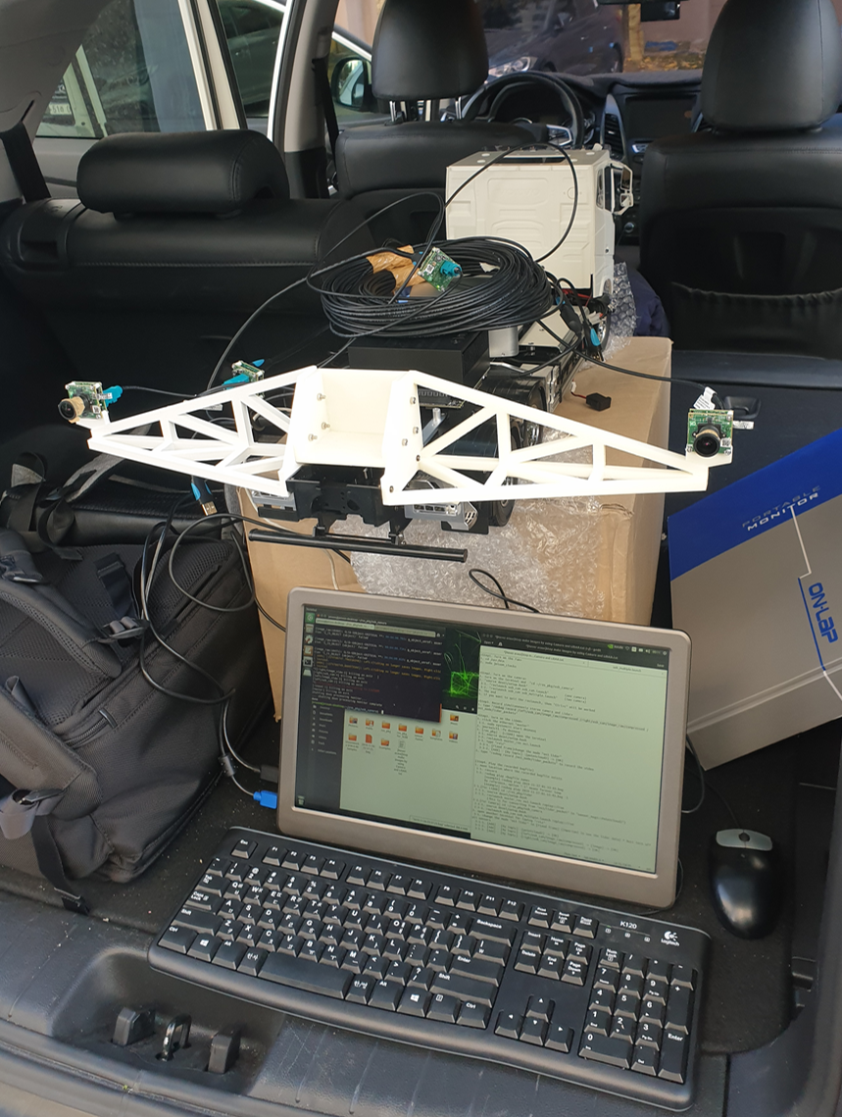
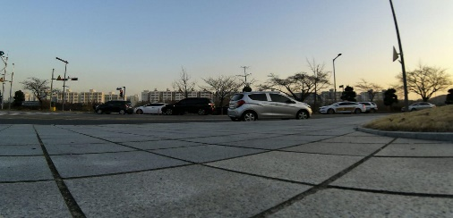
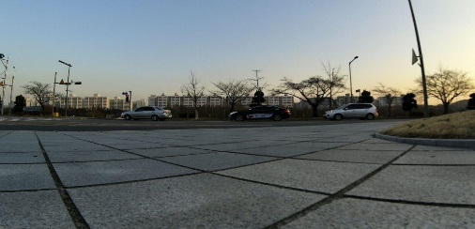
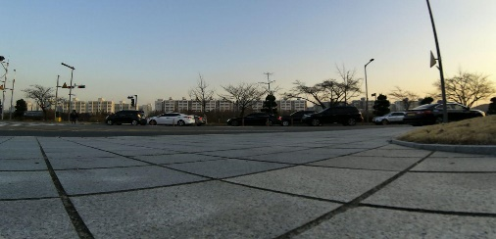
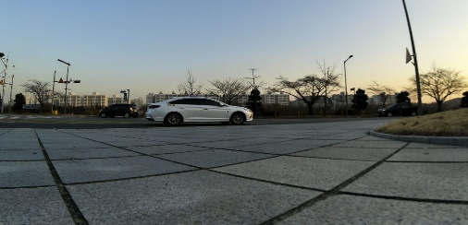
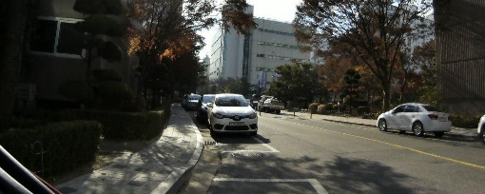
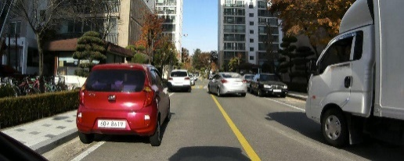
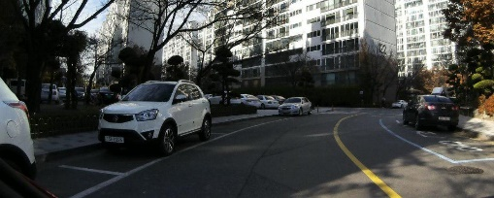
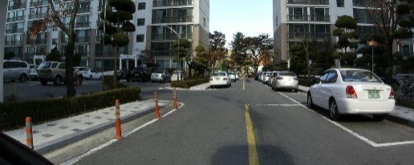
Data acquisition
Real test driving
1st test (11.27 / KAIST Front Door) : not suitable images for testing
* Problems : ① different view angle between test & training images
② Background that makes vehicle identification difficult
2nd test (11.30 / Habit @) : Good test image
Outdoor test preparation
* Similar to the training image (vehicle shape, view angle, etc…)

Slide 13
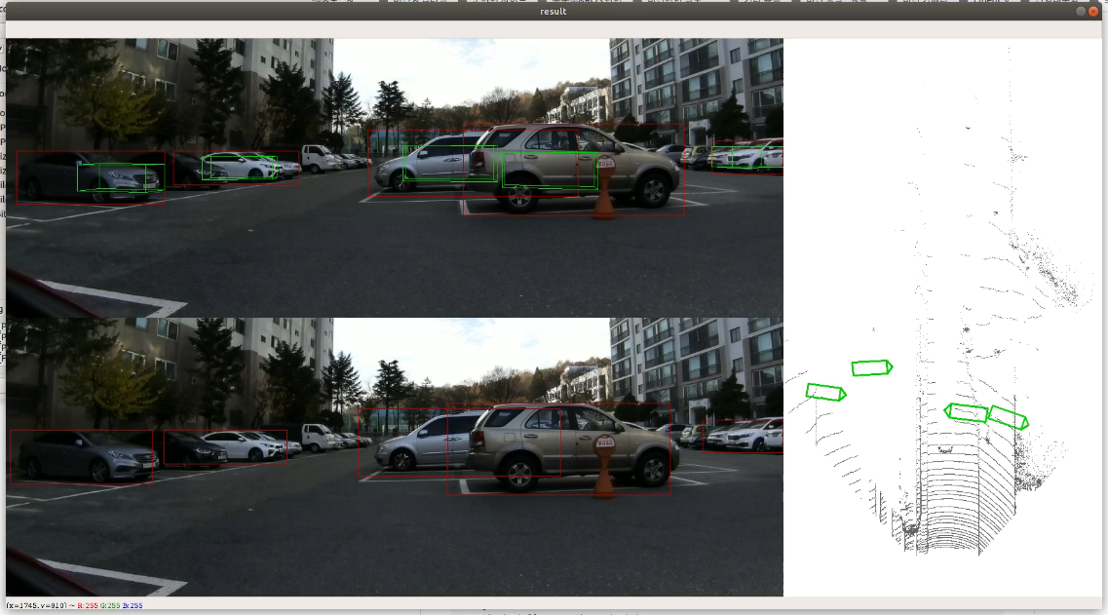
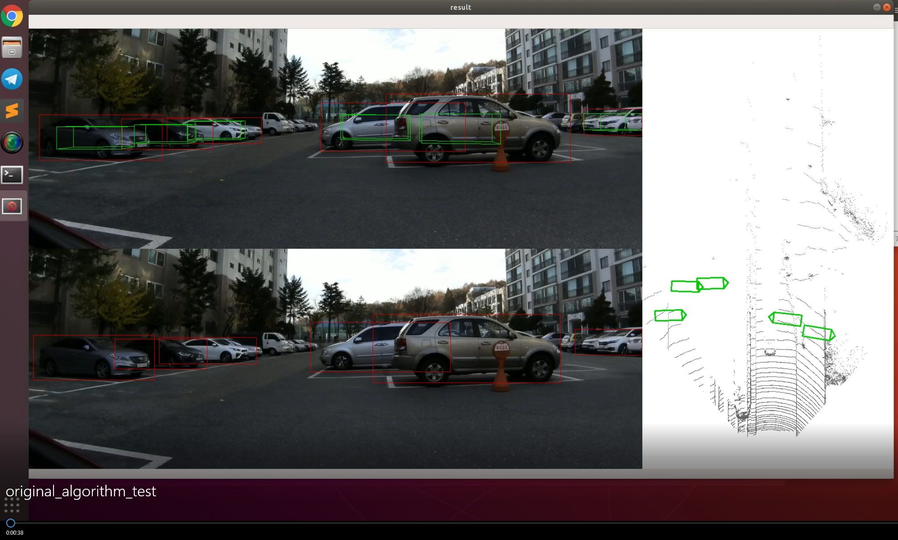
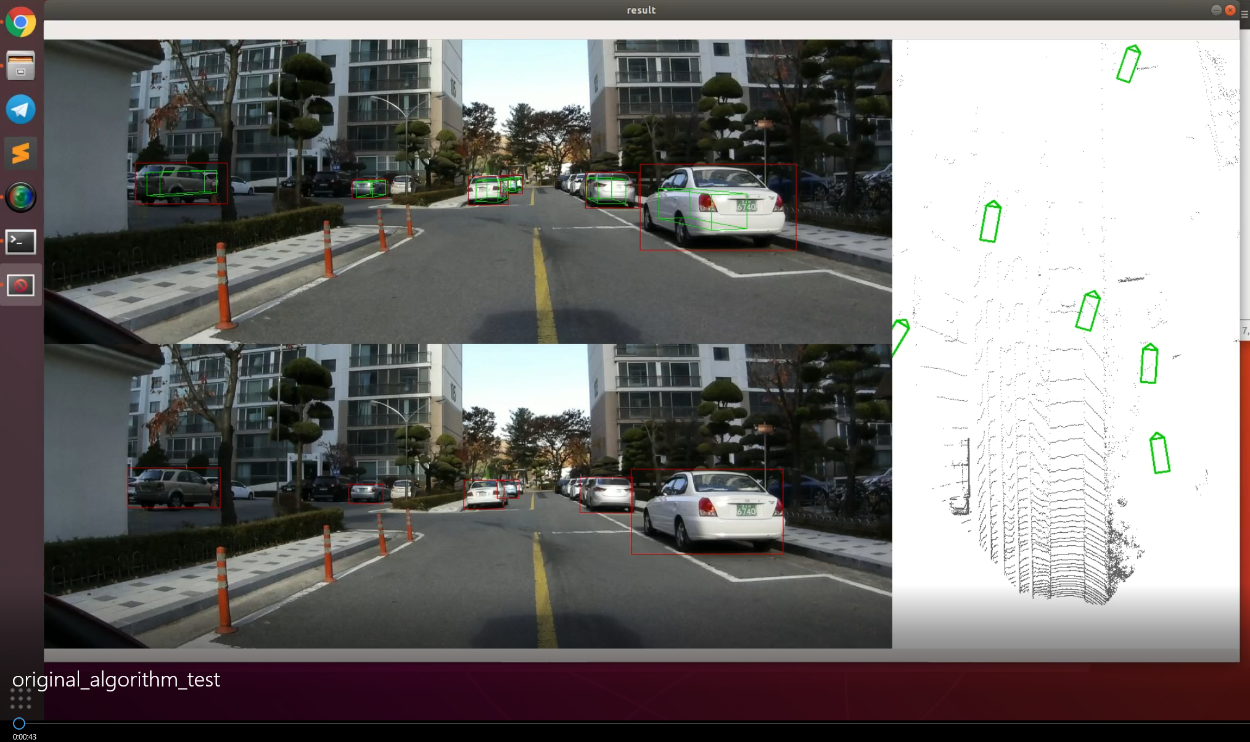
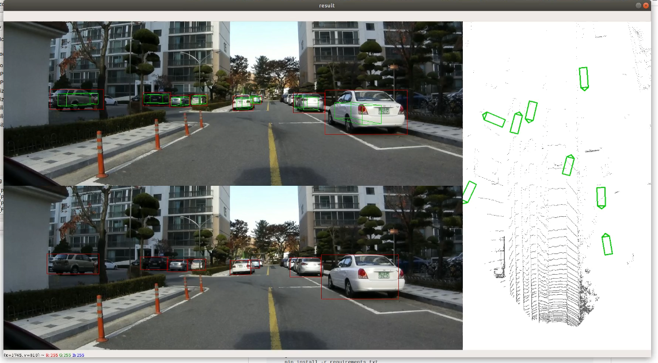
Performance of Object detection (1/2)
Simulation Result (Hanbit apartment test images)
Original algorithm
RPN change algorithm
Bird eye view
Detect more
(car side)
Bird eye view
Image #122
Bird eye view
Detect more
(Back of vehicle)
Bird eye view
Image #137

Slide 14
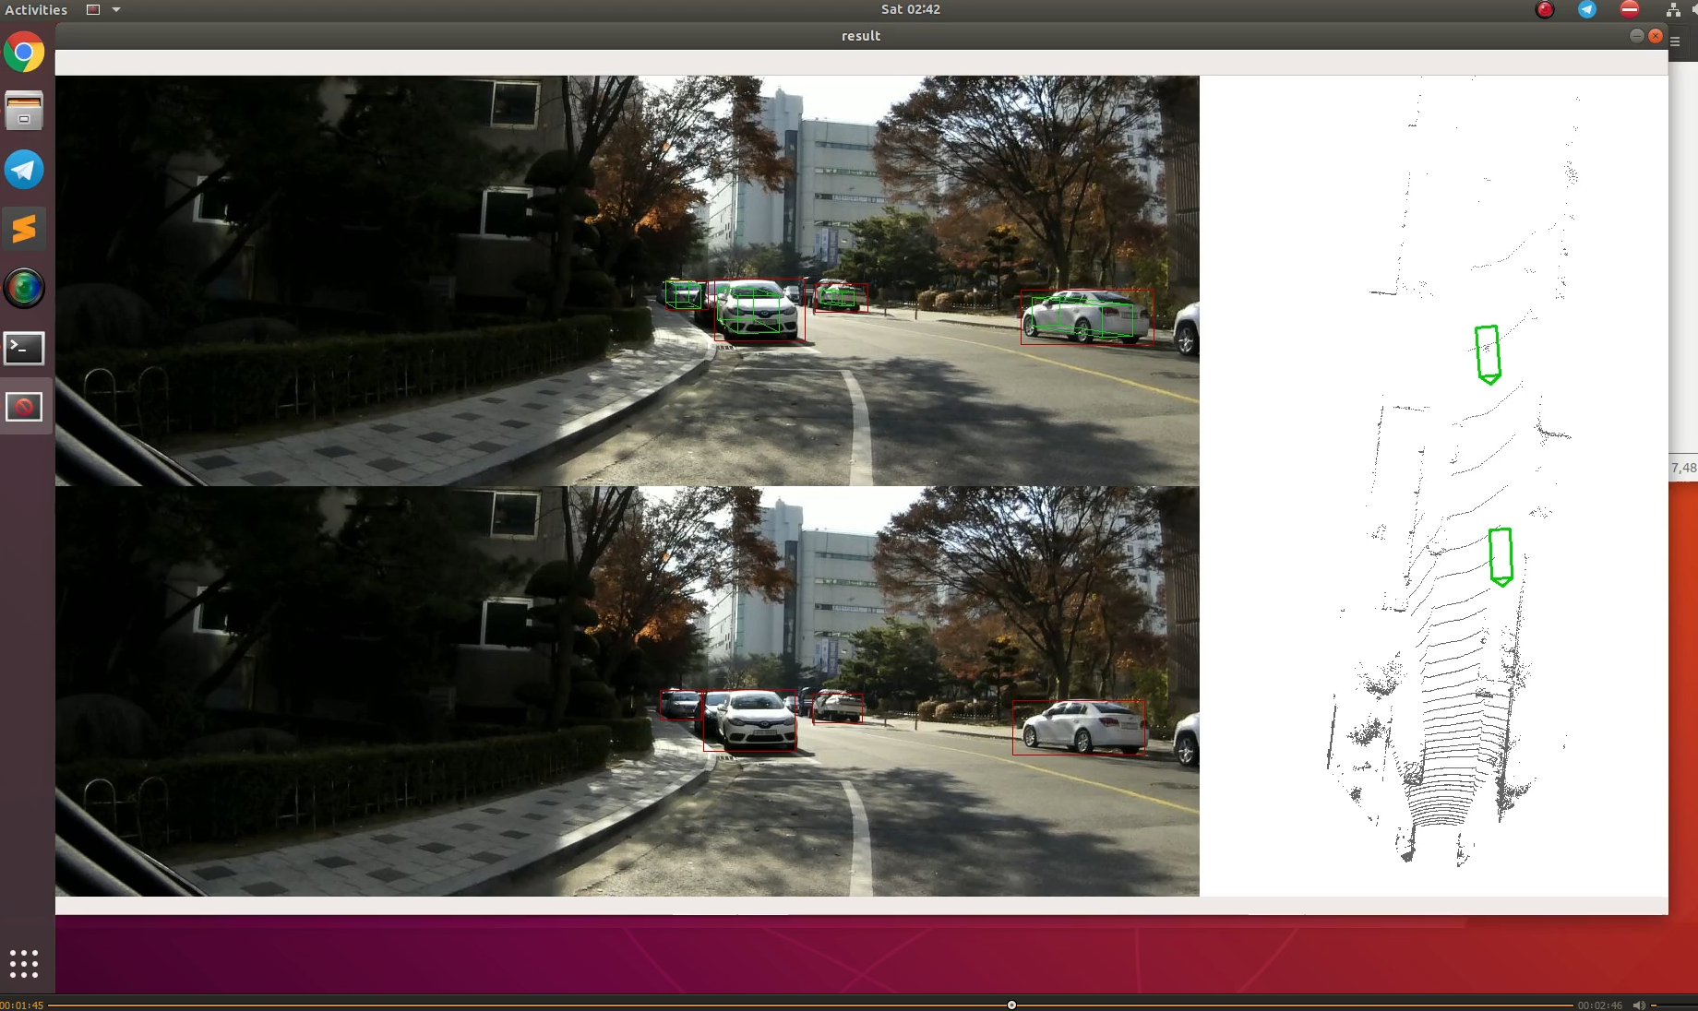
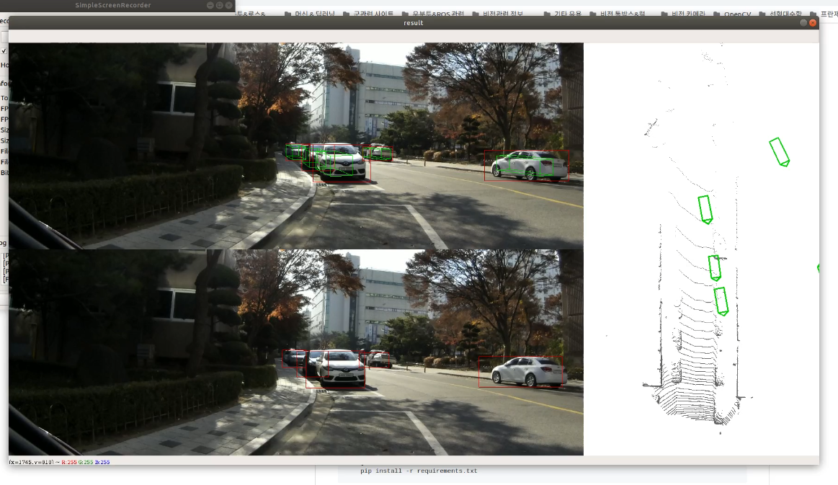
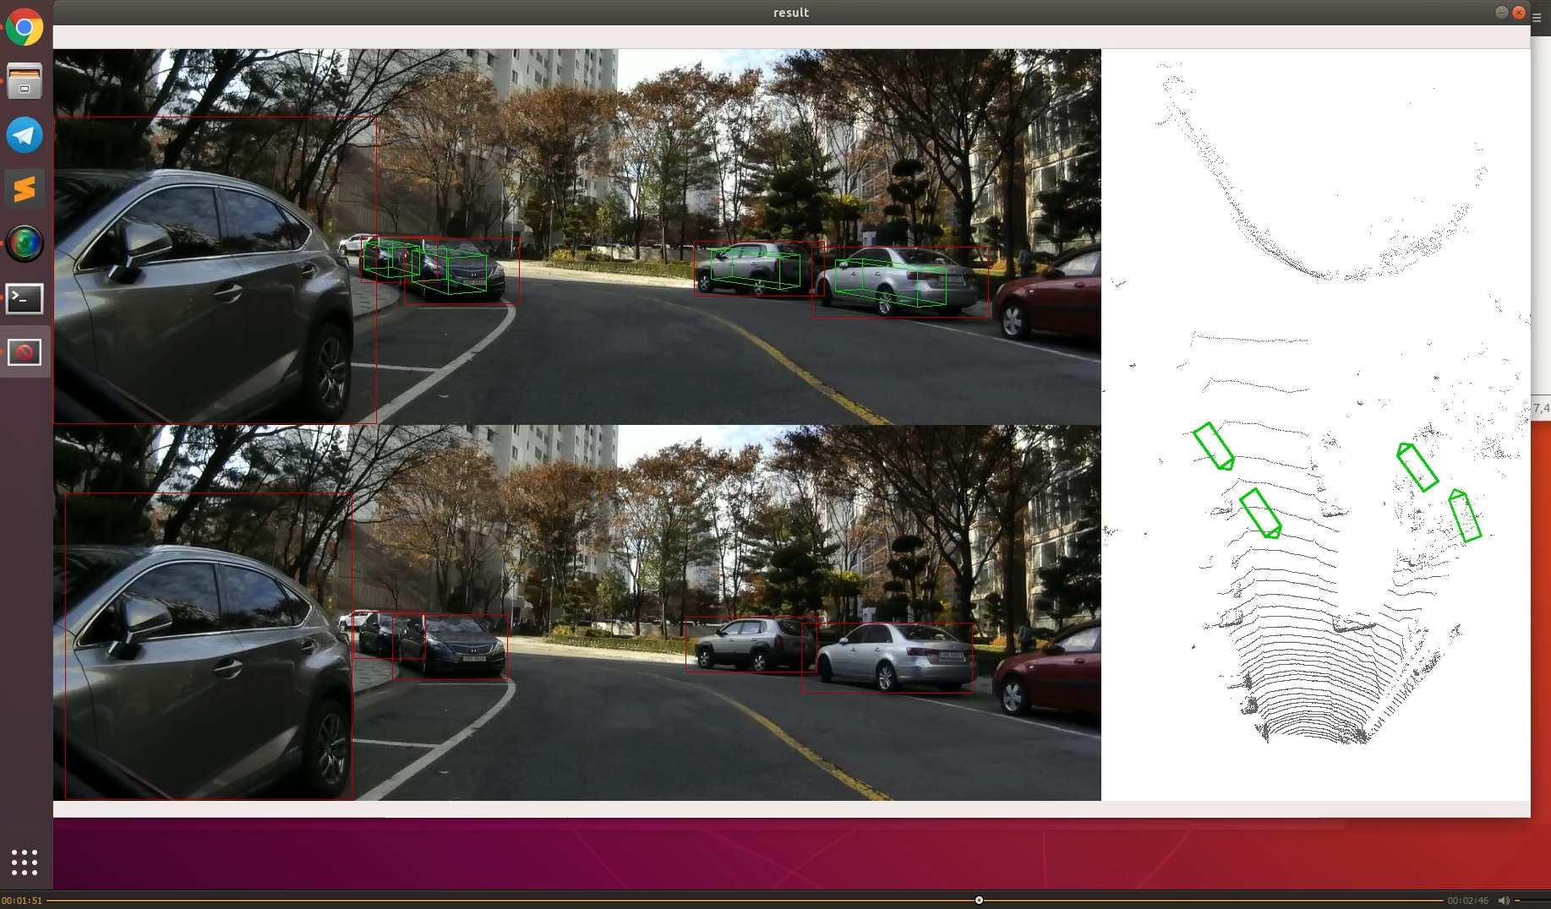
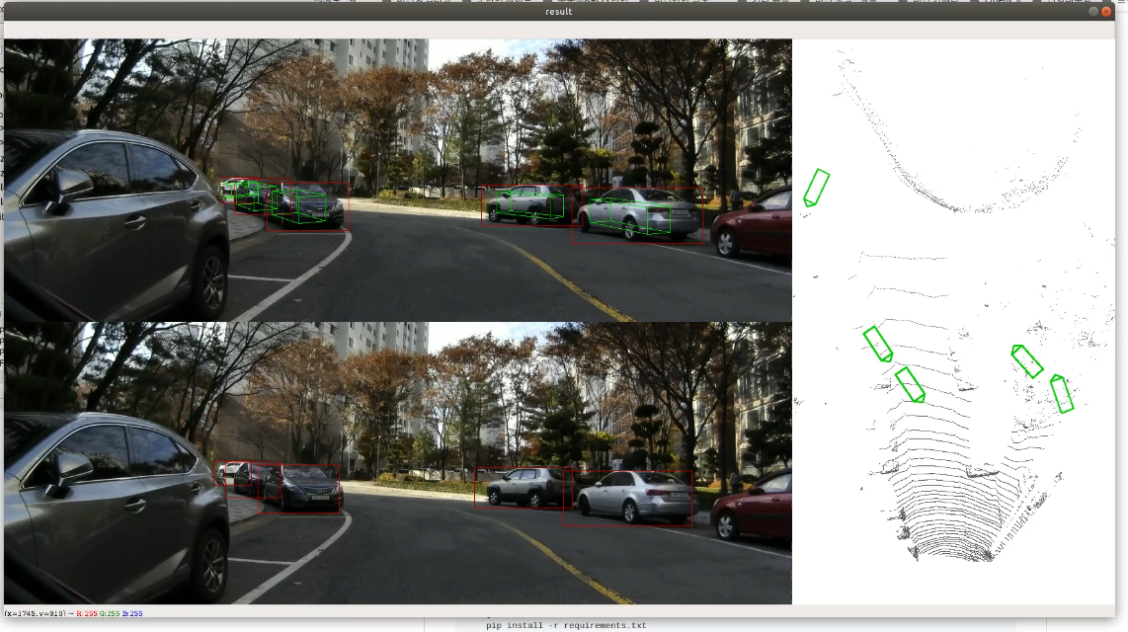
Performance of Object detection (2/2)
Simulation Result (Hanbit apartment test images)
Original algorithm
RPN change algorithm
Bird eye view
Bird eye view
Detect more
(Back of vehicle)
Detect more
(car front)
Image #354
Bird eye view
Bird eye view
Detect more
(car side)
Image #370

Slide 15
Conclusions & Further work

Slide 16
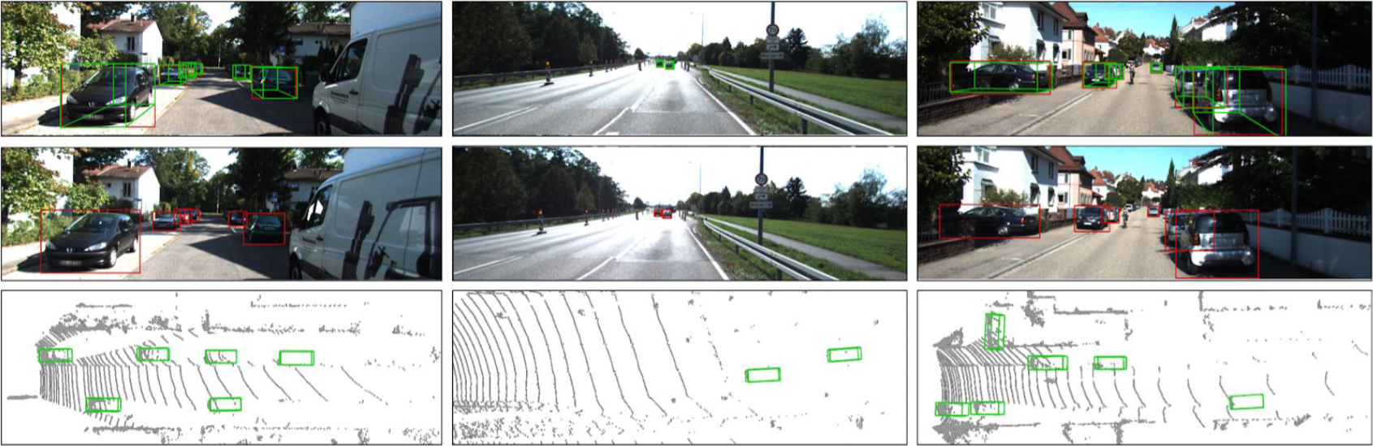
Conclusions & further work
Conclusions
Better object detection performance despite reduced number of RPNs (9 → 8)
(Image #122, #137, #345) Detect better when vehicles are even clustered
(Image # 137, #345, #370) Find more objects in the distance
In conclusion, Using RPNs that is appropriate for your environment, rather than a large number of RPNs,
will perform better on object
Further work
Improved with robust stereo vision algorithm even in Extreme env(rain, snow, and night)
Create the stereo-camera version of YOLO, and SSD algorithm
Since the collected data doesn’t contain noise, it is considered that applying the filtering process will be meaningless to confirm the our algorithm. So, implement later
Try to get test results with bird eye view by extracting the LiDAR point-cloud data

Slide 17
Q & A

Slide 18
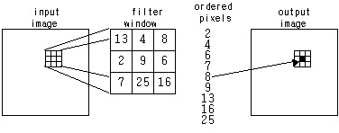
Appendix #1. Apply Hampel filter
Image
: Median of window
: Center of window
: Half window size
Median filter
Hampel filter
Filter Response
One tuning parameter: K (filter size)
MAD (Median Absolute Difference) scale estimate
Filter Response
Two tuning parameters: K (filter size), t (error bound)
Always replaced by median value of window.
Center of window is NOT outlier:
Preserve original value
Center of window IS outlier:
Replace to median value

Slide 19
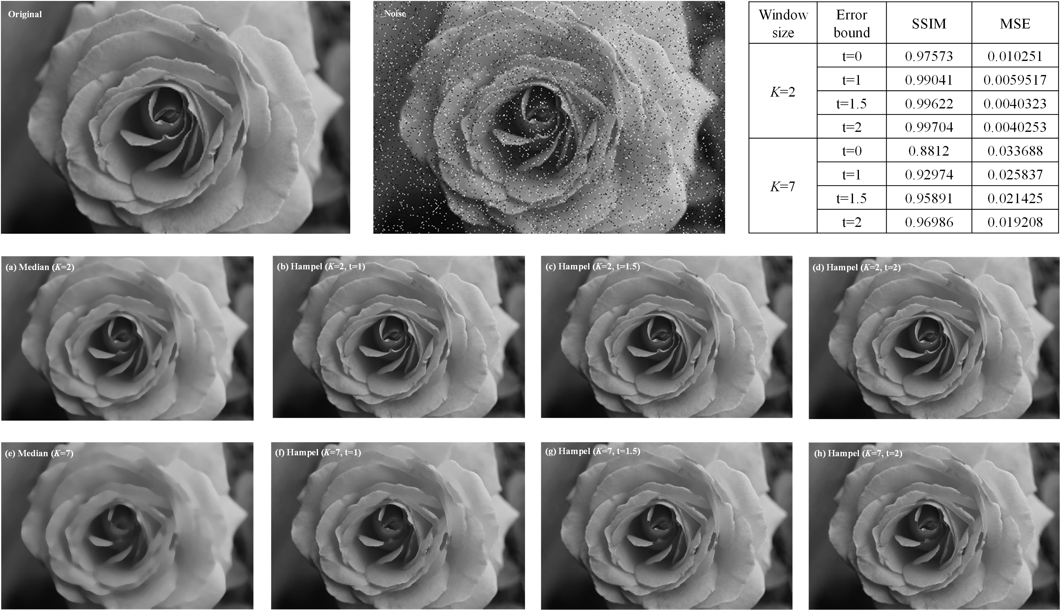
Appendix #2. Apply Hampel filter
Benefit of Hampel filter
Excellent for preserving the original image compared to other image filters like media filter which is a representative image filter.
Easy simulation through parameter tunning. In particular, the filtering intensity can be adjusted by adjusting the error bound value.
If the error bound value is set to 0, this filter can be used as a median filter.
By applying the weighted concept, it can be used as a weighted hampel filter. This can minimize the collapse of the boundary of an object in the image.
Result of Hampel filter on gray-scale image
Median filtered image
Hampel filtered image

